Slide 1
Wheelchair Mounting System
Team Members: Jake Willen, Sam Surette, Jennifer Gao
Client: James Kugler

Slide 2
Need
Tablet market will grow by a factor of five by 2017
Difficult for users of manual wheelchairs to use on the go
Ability to stow and remove mount on their own

Slide 3
Design Requirements
Lightweight and simple
Anti-theft mechanism
Requires no assistance
Does not limit mobility of chair (width and arm mobility)
Compatible with all types of manual wheelchairs
Does not impact daily activities
Easily change between stow and in use conformations

Slide 4
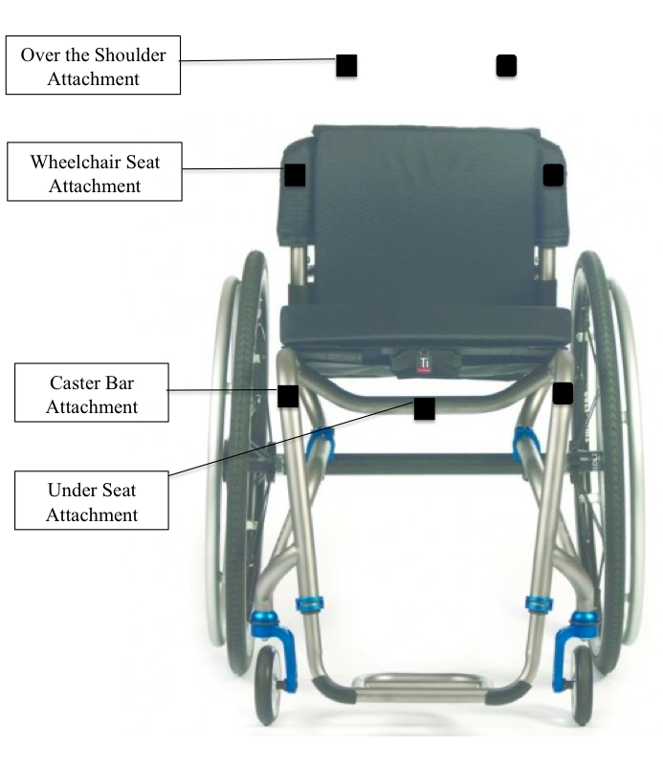
Designs
1. Attach to Body Designs
Shoulder strap
Belt Strap
2. Over Shoulder
Double bar over shoulder
Single bar over shoulder
3. Seat Attachment
Swing away
Bi-directional swing away
4. Front Bar Attachments
Caster bar
Under bar

Slide 5
Shoulder Strap Design

Slide 6
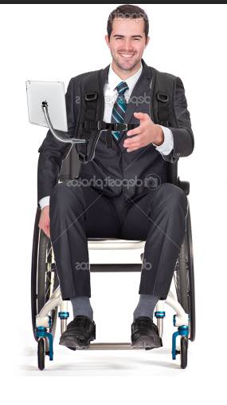
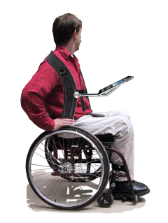

Slide 7
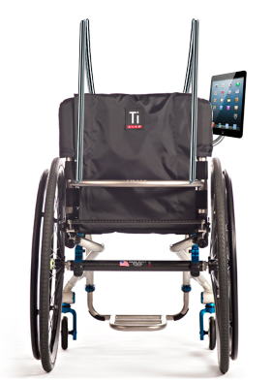
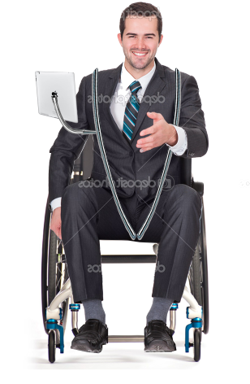
Double Bar Over Shoulder

Slide 8
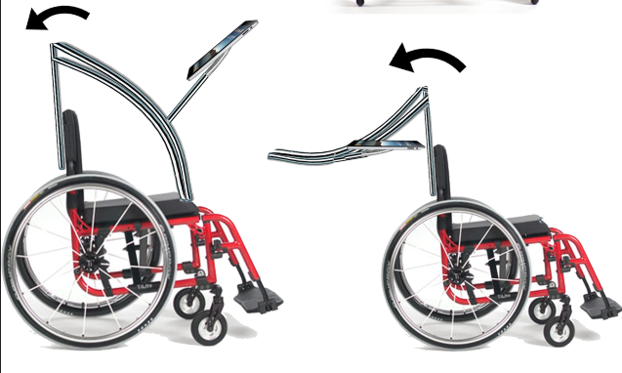

Slide 9
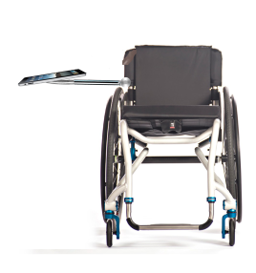
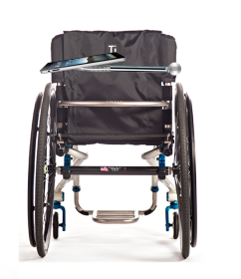
Swing-Away

Slide 10
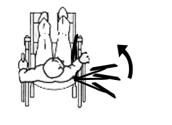

Slide 11
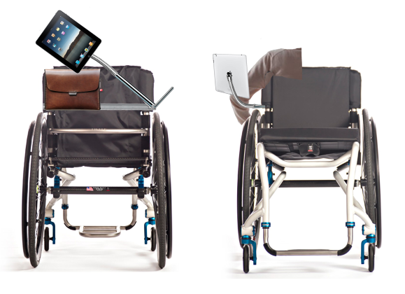
Bi-directional Swing-Away

Slide 12
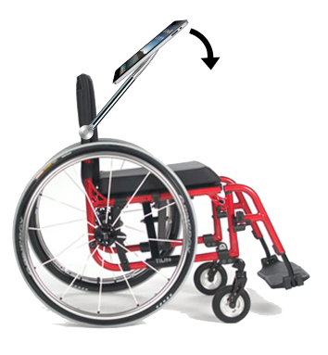
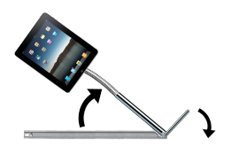

Slide 13
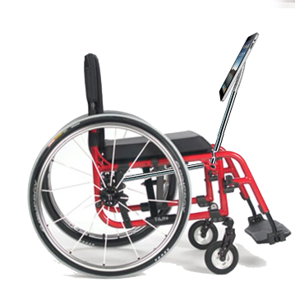
Bottom Bar Design

Slide 14
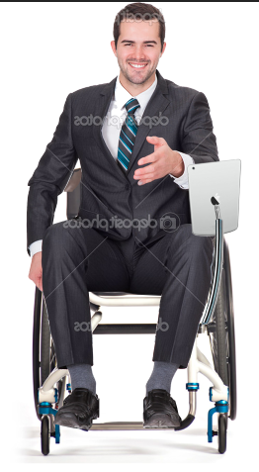
Caster Bar Design

Slide 15
Analysis Criteria
Cost
Weight
Comfort
Adjustability
Impact on Mobility
Appearance
Durability
Ease of Use
Security

Slide 16
Pugh Chart
 | Weight | Shoulder Strap | Double Bar Shoulder | Swing-Away | Under Seat | Caster Bar | Bi-directional Swing-Away
Cost | 2 | 10 | 4 | 6 | 8 | 8 | 6
Weight | 2 | 10 | 4 | 8 | 8 | 8 | 8
Comfort | 6 | 2 | 2 | 8 | 4 | 4 | 8
Adjustability | 8 | 2 | 2 | 8 | 4 | 6 | 8
Impact on Mobility | 10 | 4 | 2 | 6 | 2 | 2 | 8
Appearance | 6 | 2 | 2 | 8 | 4 | 4 | 8
Durability | 8 | 2 | 6 | 6 | 8 | 8 | 8
Ease of Use | 10 | 4 | 2 | 6 | 2 | 6 | 8
Security | 10 | 6 | 6 | 6 | 6 | 6 | 8
Total |  | 236 | 204 | 416 | 276 | 332 | 492

Slide 17
Best Design: Bi-directional Swing-Away
Key Benefits:
Maximum functionality when stowed
Ease of use in narrow spaces
Aesthetically pleasing

Slide 18
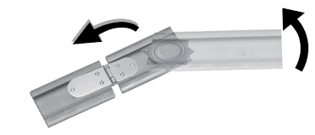
Best Design: Bi-directional Swing-Away
C-clamp to hold mount to back of chair
Grasps each side of chair
Twisting mechanism to lock in place
Bi-directional Hinge and Swivel system
Allows bar to swivel up and then hinge/fall forward

Slide 19
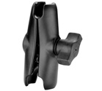
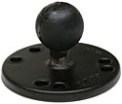
Chosen Design: Bi-direction Swing-Away
Telescoping rod
Can shorten bar when stowed
Gooseneck
Fine adjustment of tablet
Ball and Socket Attachment
Maximum rotation
Security
Case
Safe storage in back of chair

Slide 20
Design Schedule
Tuesday, 2:30-5:30
Wednesday, 12:00-3:00
Saturday, 12:00-3:00
Sunday, 12:00-3:00pm
Contact manufacturers to find details about specific parts
Work on 3-D CAD design
DesignSafe

Slide 21
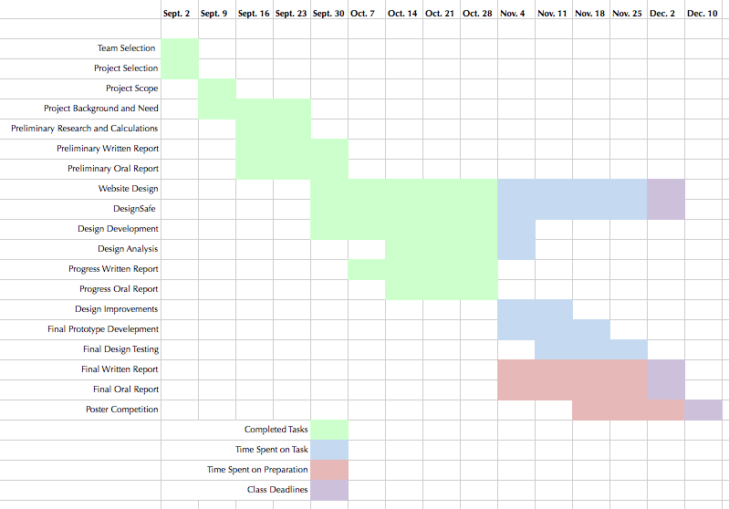
Design Schedule

Slide 22
Team Responsibilities
Jake Willen
DesignSafe
Calculations
Research
Jennifer Gao
Management and organization responsibilities
Contact with client
Weekly Reports
Sam Surette
Design drawings using CAD or other application
Maintenance of Website
All
Design Development
Design Testing
Brainstorming Design Improvements

