Slide 1
Wheelchair Mounting System
Jennifer Gao, Sam Surette, Jake Willen

Slide 2
Overview
Need
Scope
Background
Design Requirements
Existing Solutions/Patents
Preliminary Calculations
Schedule
Organization of Team Responsibilities

Slide 3
Overview
Need
Scope
Background
Design Requirements
Existing Solutions/Patents
Preliminary Calculations
Schedule
Organization of Team Responsibilities

Slide 4
Need
Tablet market will grow by a factor of five by 2017
Both hands required for manual wheelchair locomotion
Unmet need for tablet computer mounting system for manual wheelchairs

Slide 5
Overview
Need
Scope
Background
Design Requirements
Existing Solutions/Patents
Preliminary Calculations
Schedule
Organization of Team Responsibilities

Slide 6
Scope
Personal technology is not a luxury
Terrain Tracker
Objective: Create tablet computer mounting system for wheelchair users
Easily accessed and stowed
Sturdy, theft-proof
Does not inhibit mobility
Can be installed on manual wheelchairs

Slide 7
Overview
Need
Scope
Background
Design Requirements
Existing Solutions/Patents
Preliminary Calculations
Schedule
Organization of Team Responsibilities

Slide 8
Background: Demographics
1.5% of US population (3.6 million) uses wheelchairs
56% of wheelchair users are 65 or older
17% of US population (52.4 million) uses tablets
Age Group | % of Tablet Users
13-17 | 5.50
18-24 | 13.00
25-34 | 24.20
35-44 | 20.60
45-54 | 18.10
55-64 | 11.00
65+ | 7.60

Slide 9
Background: Tablet Computer Industry
Apple sold 19.5 million iPads worldwide in Q1 2013
59% increase in shipments compared to previous year
Products strike a balance between portability and functionality

Slide 10
Background: Mobile Applications
Terrain Tracker
Mobile Banking
Emergency Medical Support
Productivity
Entertainment

Slide 11
Background: Wheelchairs
Wheelchair Type | Weight (lbs)
Standard Chair | 35-45
Lightweight Chair | 30-35
Folding Ultralight Chair | 25-30
Rigid Ultralight | 12-25
Sports Chair | 25-35

Slide 12
Background: Wheelchairs

Slide 13
Background: Seat Cushions

Slide 14
Overview
Need
Scope
Background
Design Requirements
Existing Solutions/Patents
Preliminary Calculations
Schedule
Organization of Team Responsibilities

Slide 15
Design Requirements
Maintains full range of motion
Is not prohibitively heavy
Compatible with all types of chairs
Has anti-theft measures
Requires no assistance
Does not unbalance chair

Slide 16
Overview
Need
Scope
Background
Design Requirements
Existing Solutions/Patents
Preliminary Calculations
Schedule
Organization of Team Responsibilities

Slide 17
Existing Solutions: Ram Mounts
Aesthetically pleasing
Sturdy
Not specifically designed for wheelchairs

Slide 18
Existing Solutions: Daessy
Specifically designed for wheelchairs
Includes swing-aside and folding mounts
Heavy, requires assistance

Slide 19
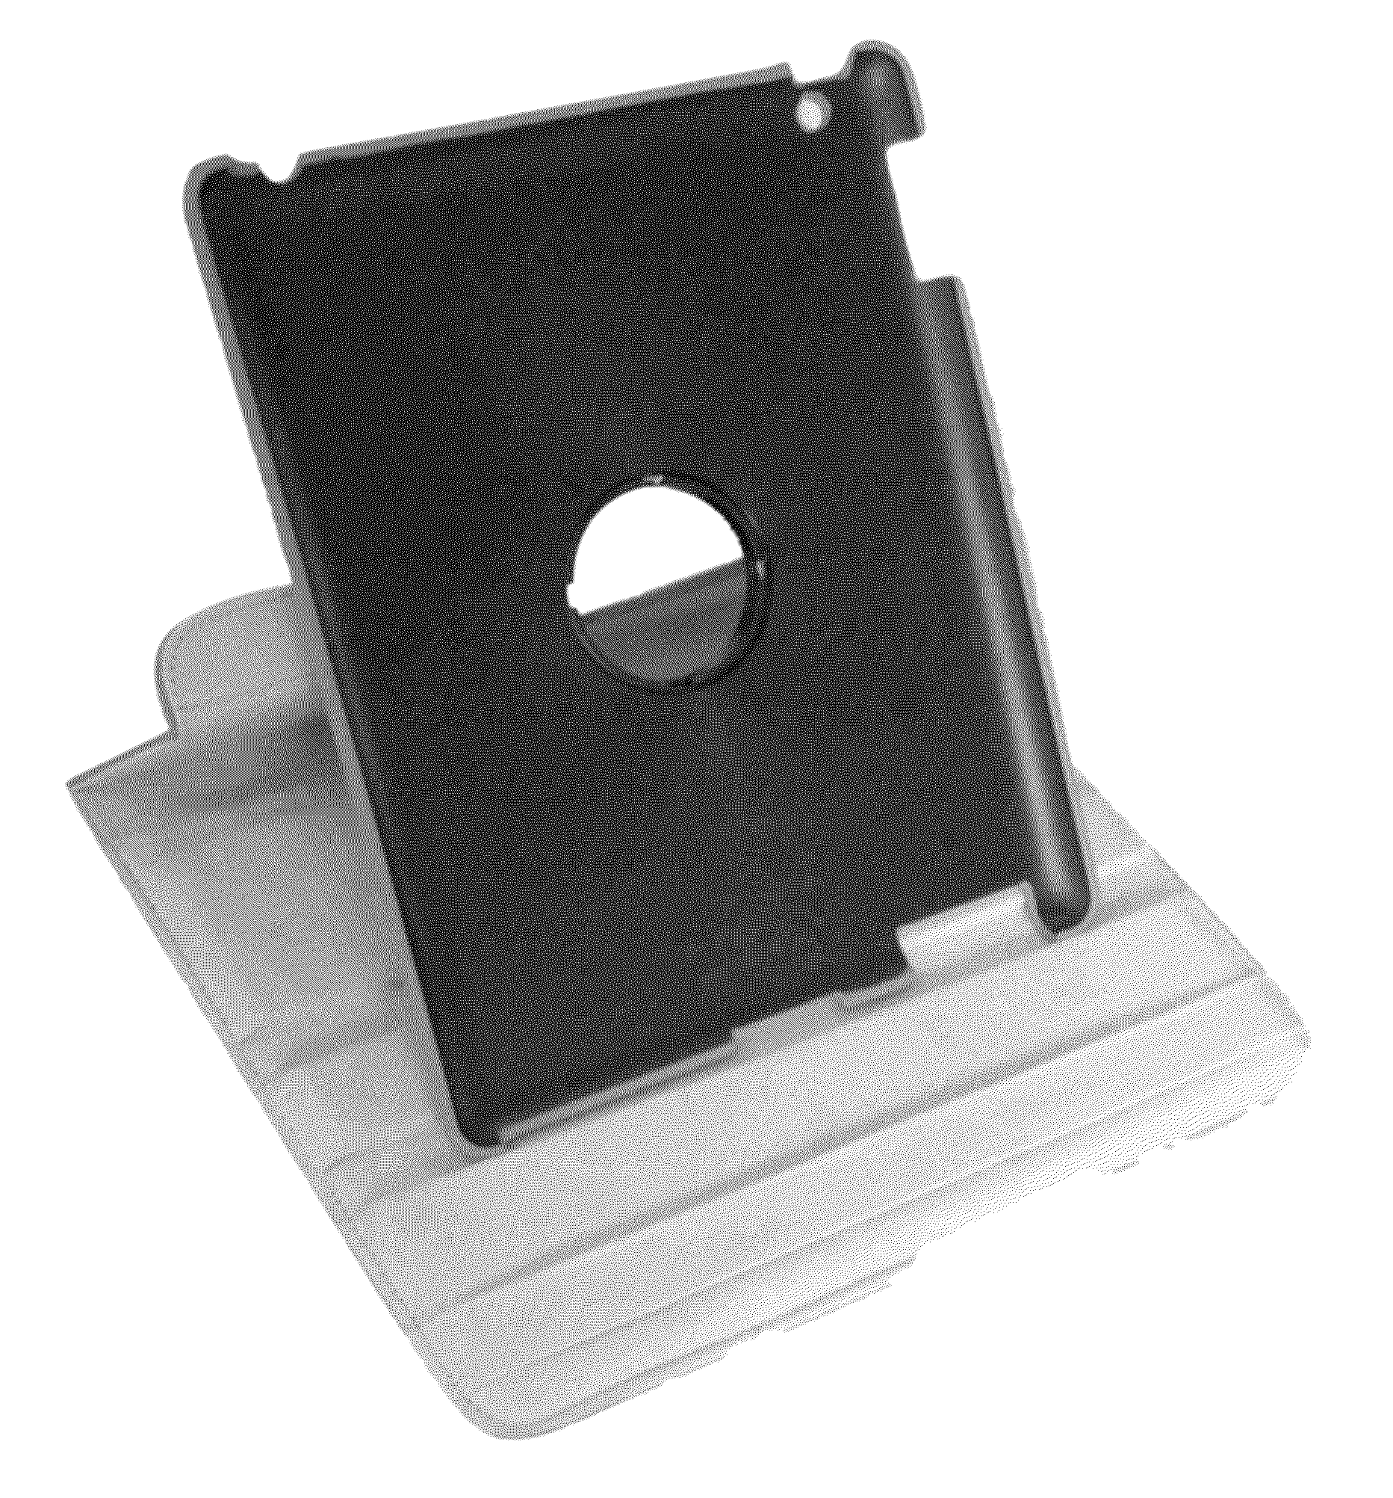
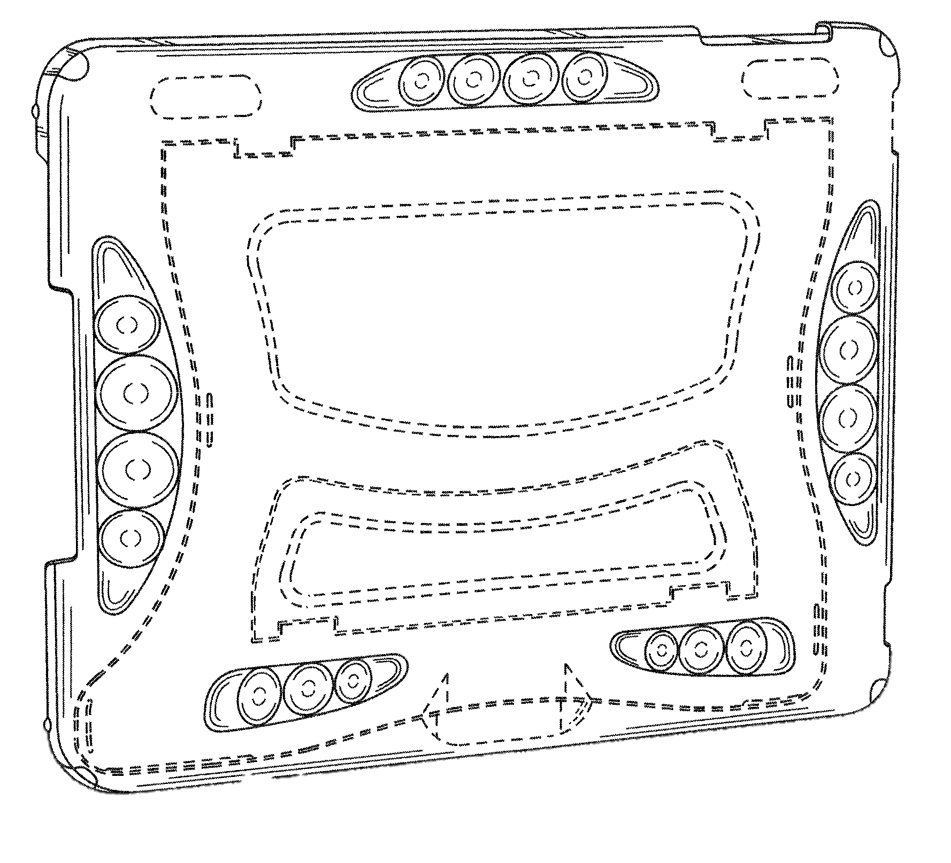
Existing Solutions: Cases

Slide 20
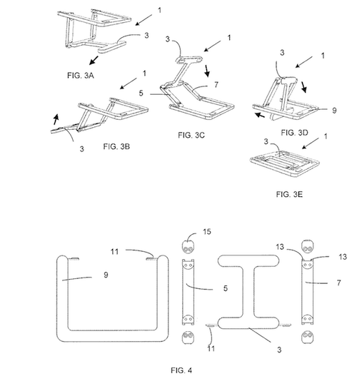
Existing Solutions: Mount Designs

Slide 21
Existing Solutions: Mount Designs

Slide 22
Existing Solutions: Mount Designs

Slide 23
Existing Designs: Mount Attachments

Slide 24
Existing Designs: Mount Attachments

Slide 25
Overview
Need
Scope
Background
Design Requirements
Existing Solutions/Patents
Preliminary Calculations
Schedule
Organization of Team Responsibilities

Slide 26
Preliminary Calculations

Slide 27
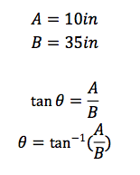
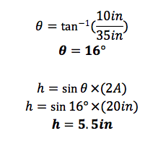
Preliminary Calculations

Slide 28
Preliminary Calculations Example: Rear Mount
∑M_{WHEEL}=0
0 = W_{MOUNT}L_{MOUNT} + 2F_{CASTER}(L_{CASTER} + L_{WHEEL}) - W_{CHAIR}L_{WHEEL}
-W_{MOUNT}L_{MOUNT} = 100 F_{CASTER} – 200(5)
-15L_{MOUNT} = -1000
L_{MOUNT} = 66.67 cm
Maximum distance 15N mount can be without tipping is 66.67 cm behind bottom of the wheel.

Slide 29
Overview
Need
Scope
Background
Design Requirements
Existing Solutions/Patents
Preliminary Calculations
Schedule
Organization of Team Responsibilities

Slide 30
Schedule
Tuesday, 2:30-5:30pm
Wednesday, 12:00-3:00pm
Saturday, 12:00-3:00pm
Sunday, 10:00am-1:00pm
Create CAD designs during week
Test using 3D printer on weekend

Slide 31
Schedule: Milestones

Slide 32
Overview
Need
Scope
Background
Design Requirements
Existing Solutions/Patents
Preliminary Calculations
Schedule
Organization of Team Responsibilities

Slide 33
Organization of Team Responsibilities
Jennifer
Management and organization responsibilities
CAD designs
Sam
CAD designs - experience with CAD because of Mechanical Engineering minor
Website formatting - experience with own website, Slantable
Jake
Calculations
DesignSafe

