Slide 1
Wheelchair Mounting System
Group 12: Jennifer Gao, Sam Surette, Jake Willen
December 2, 2013

Slide 2
Overview
Need
Design Requirements
Design Overview
Design Details
Design Analysis
Materials & Manufacturing
Conclusion

Slide 3
Need
There is a need for a tablet mounting system for wheelchairs that allows for easy stow and use of a tablet computer for users of wheelchairs while on the go.

Slide 4
Design Requirements
Width:
  Add <2” to total width of wheelchair
Stowed Position:
  Behind seatback (14-22” width, 6-16.5” height)
Extended Position:
  Average arm’s length (18”)
Weight:
  <9lbs
Security:
  Secure tablet to mounting system
  Secure mounting system to wheelchair
  Hide tablet from view when in stowed position

Slide 5
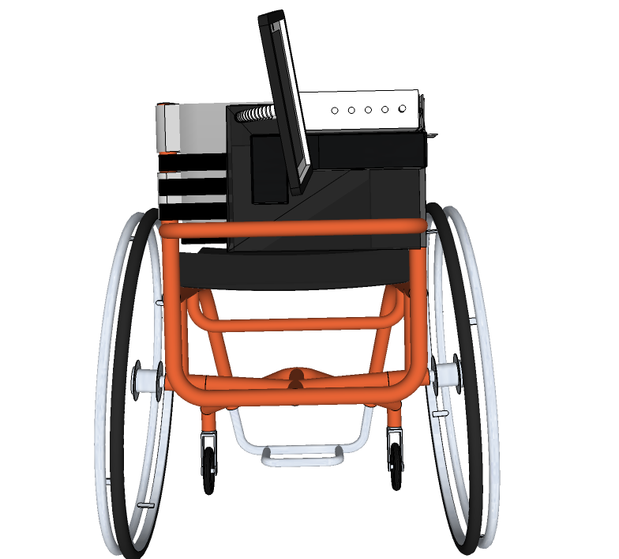
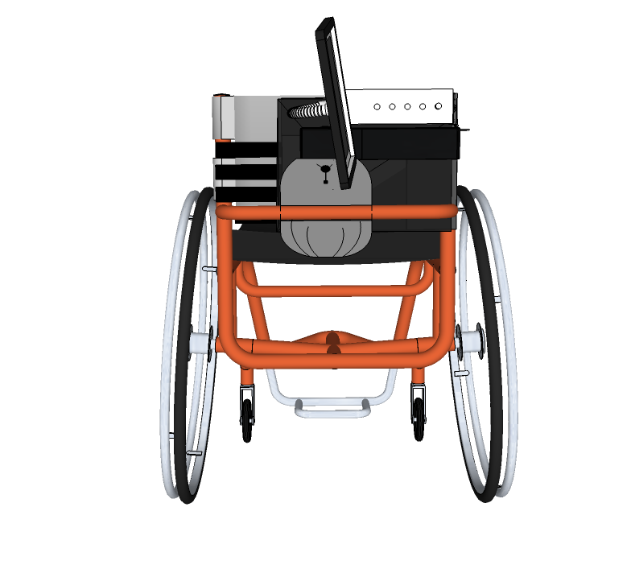
Design Overview
Stowed Position
Stowed Position

Slide 6
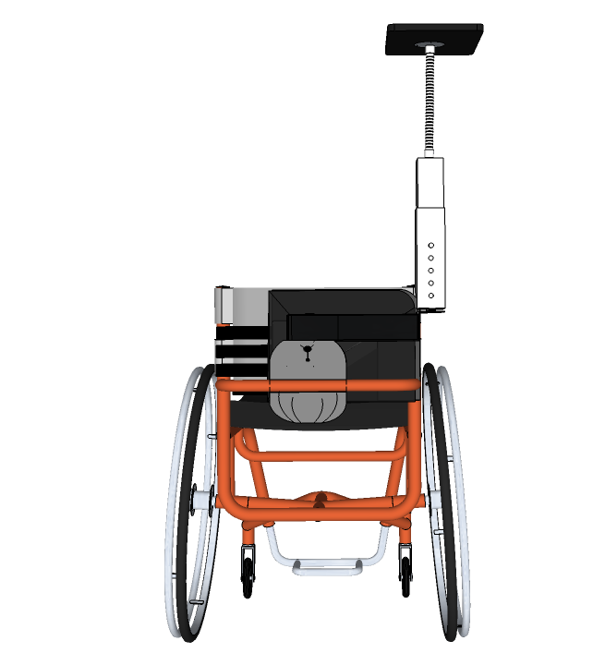
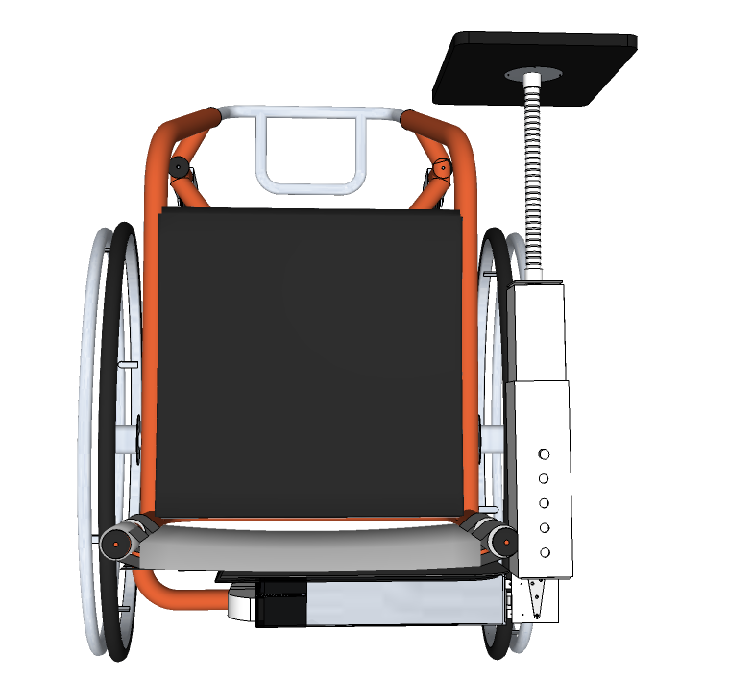
Design Overview
Intermediate Position
Extended Position
View from Behind
View from Above

Slide 7
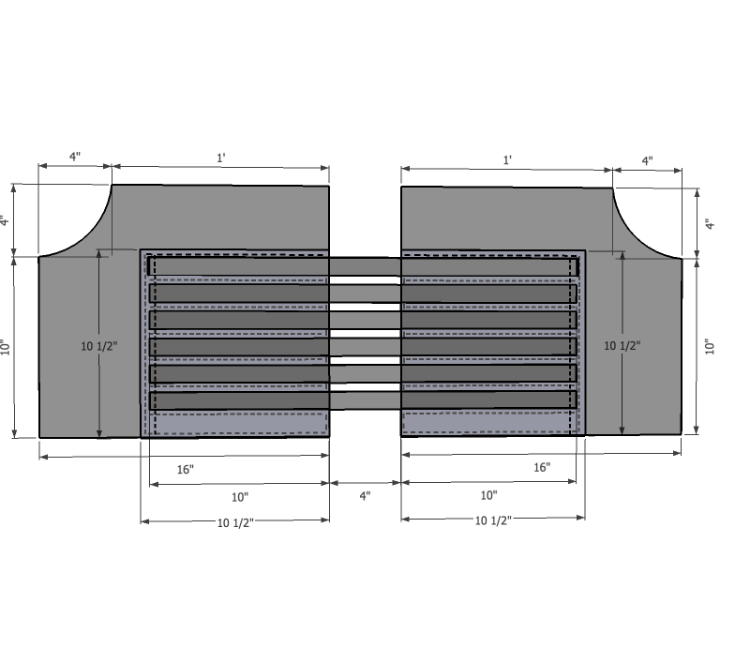
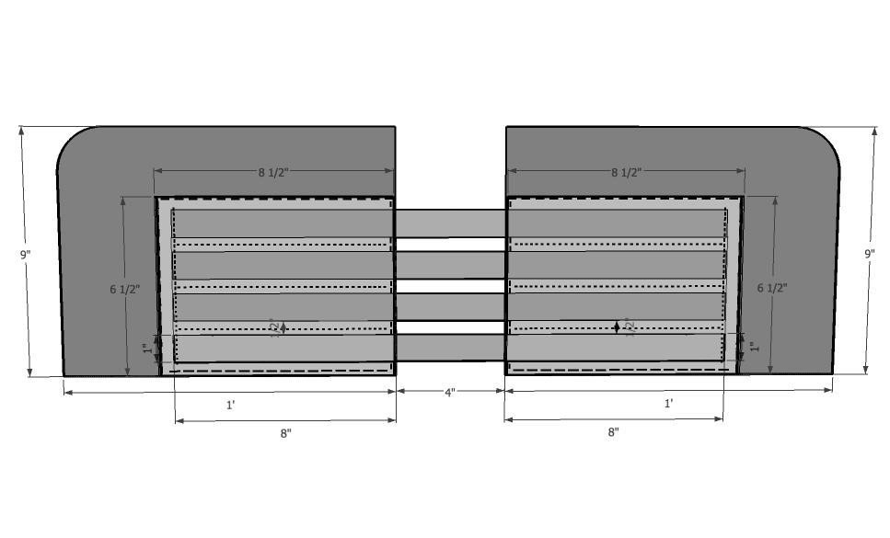
Design Details
Ultralight Sleeve
Standard Sleeve
Seat Width: 14-18”
Seat Height: 6-11”
Seat Width: 18-22”
Seat Height: 11-16.5”
Accommodates handles

Slide 8
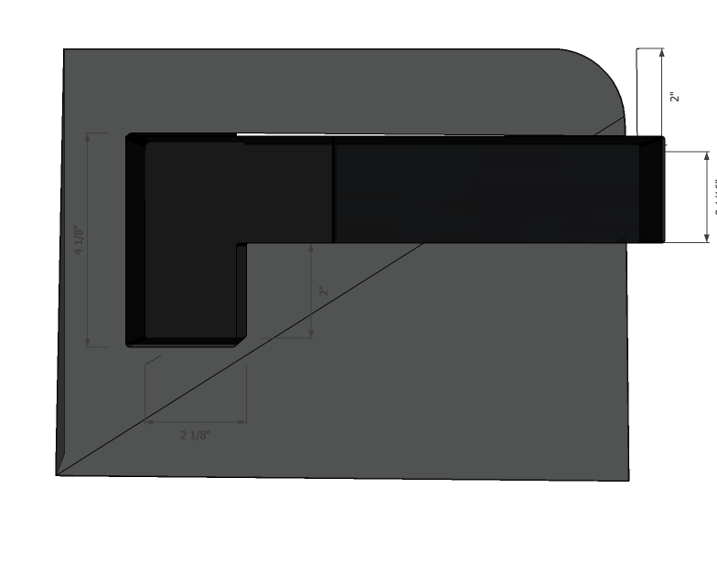
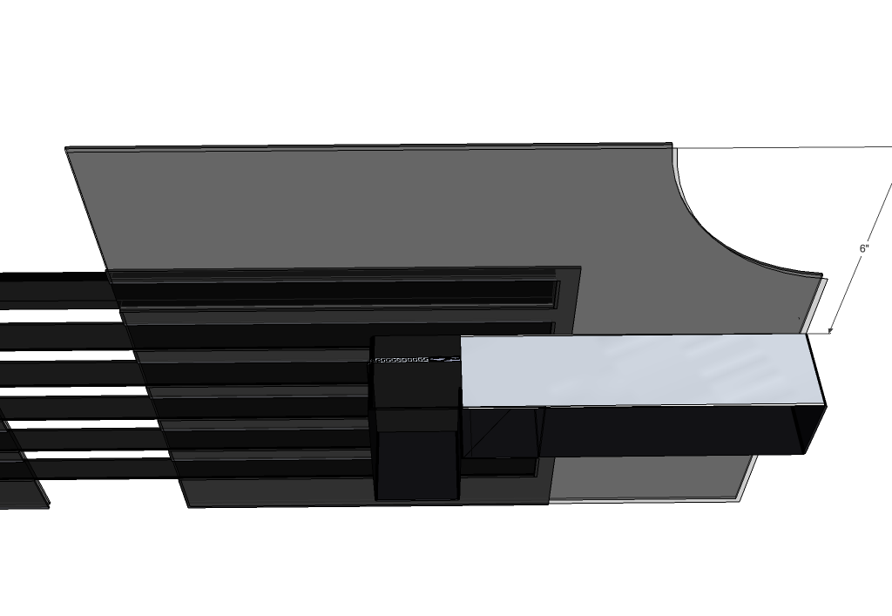
Design Details
Ultralight L-Bar Sleeve
Standard L-Bar Sleeve
2” from top
6” from top

Slide 9
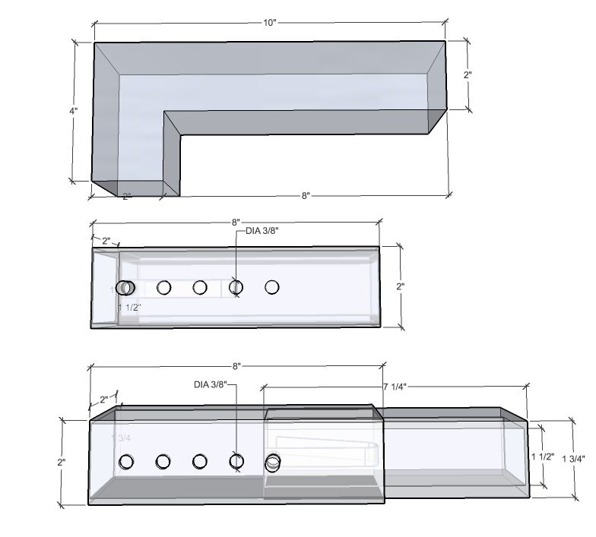
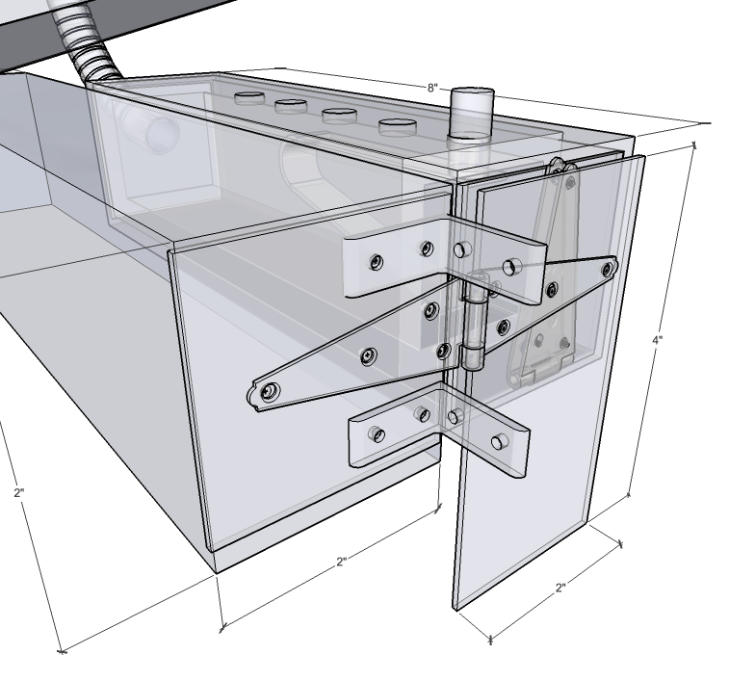
Design Details
Bar Components
Hinging System
Stowed, view from side

Slide 10
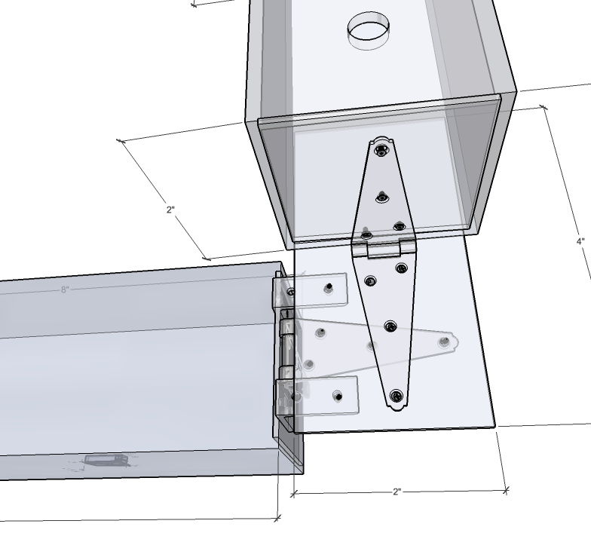
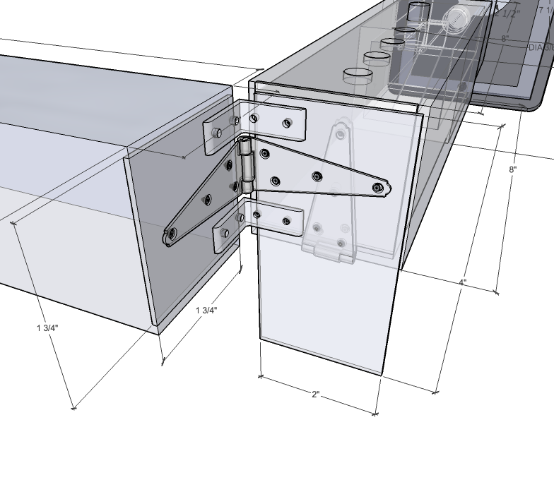
Design Details
Intermediate Position
Extended Position
View from below
View from above

Slide 11
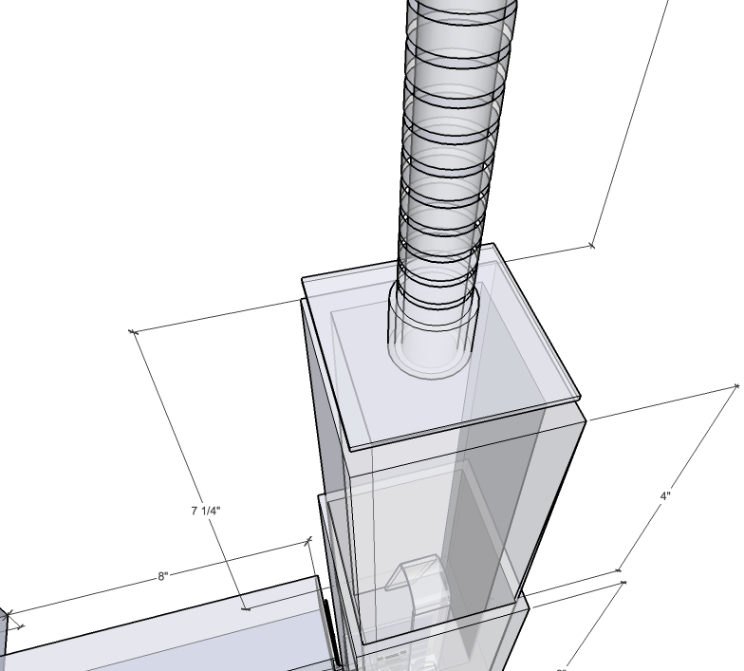
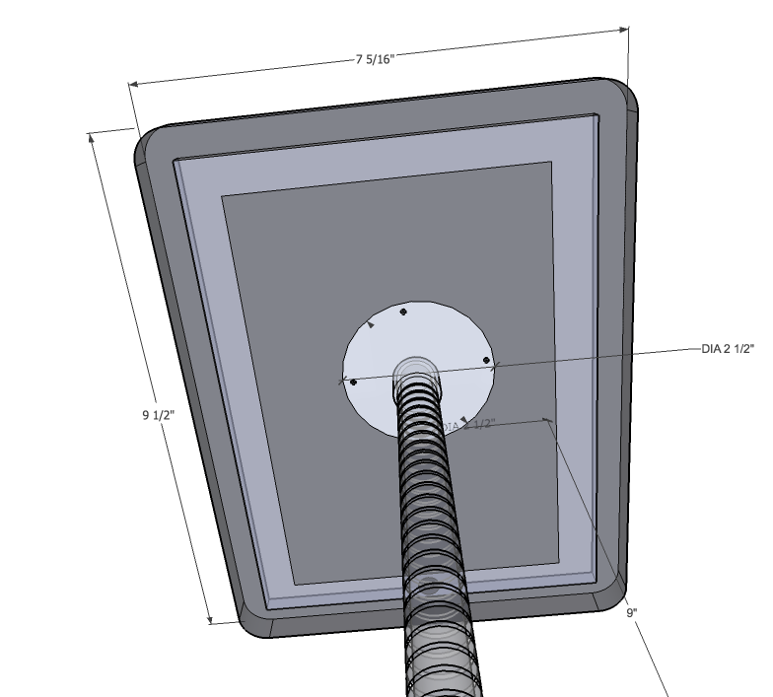
Design Details
9” Gooseneck to Telescoping Tube
9” Gooseneck to Tablet Holder

Slide 12
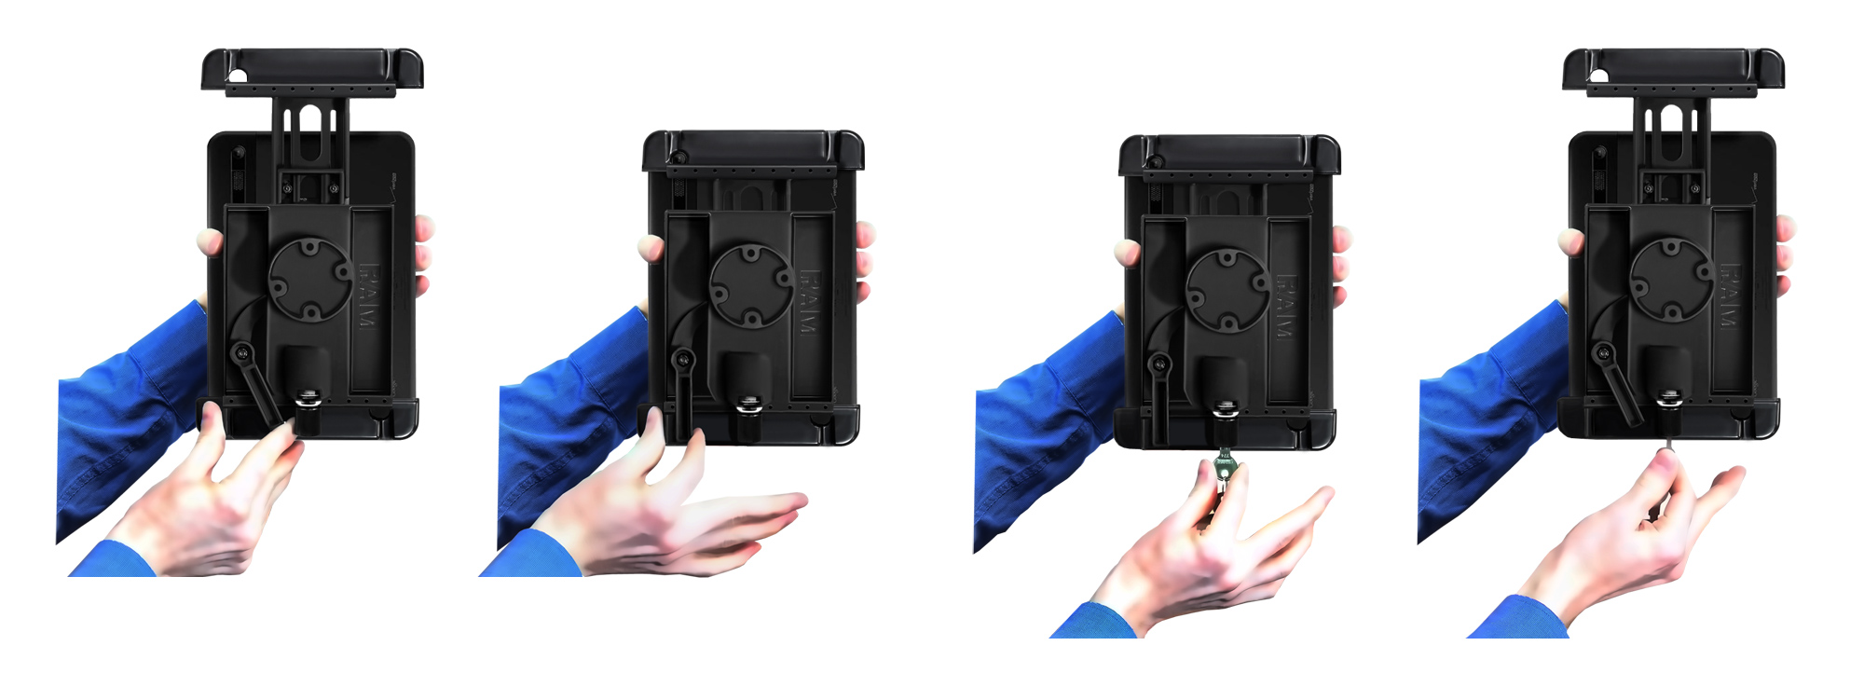
Design Details
RAM Tab-Lock™ Universal Locking Holder

Slide 13
Design Analysis
Mass = Density * Volume
Total Mass = 8.11 lbs
Total Mass of Components Supported by Hinge System = 5.33 lbs

Slide 14
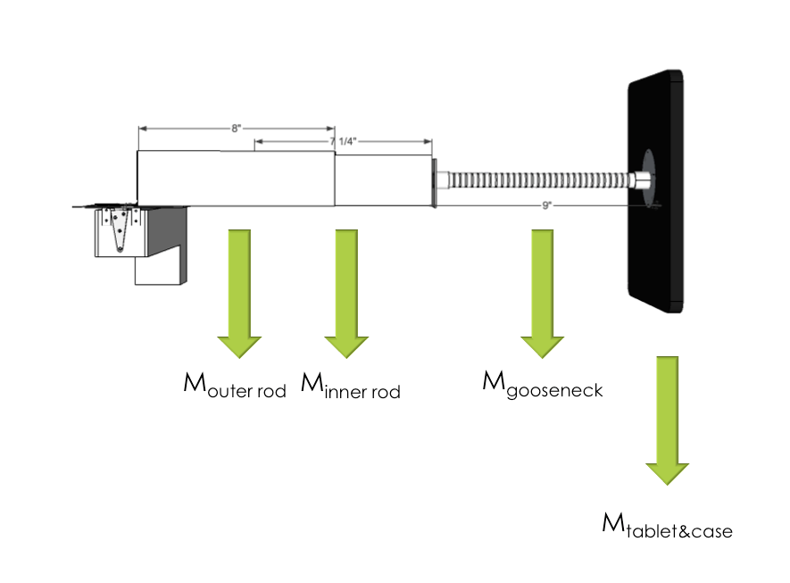
Design Analysis
∑M=(1.55lb)(32.174ft/s²)(1.75ft) + (0.474lb)(32.174ft/s²)(1.325ft) + (1.456lb)(32.174 ft/s²)(0.968ft) + (1.85ft)(32.174 ft/s²)(0.33ft)
∑M=173.23 lb*ft

Slide 15
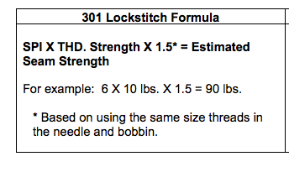
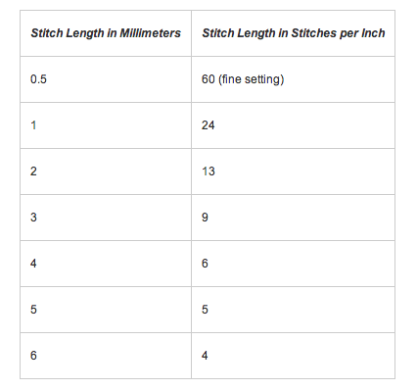
Design Analysis
Estimated Seam Strength:
9 x 53 lbs x 1.5 = 715.5 lbs

Slide 16
Materials & Manufacturing
Name of Product | Product Number | Price/Unit | Lead Time | Amount Needed
Duck Fabric | 8775K4 (McMaster-Carr) | $2.51/ft | Ships Next Day | 24.5” (Standard) 18.5” (Ultralight)
Elastic Straps | 88225K68 (McMaster-Carr) | $9.85/roll | Ships Next Day | 12’/36’ (Standard) 6’8”/36’ (Ultralight)
Zipper | YKK #3 (Zipperstop.com) | $0.50 for 1-10 | Ships Same or Next Day | 1/1
Nylon Thread | 87695K33 (McMaster-Carr) | $7.74 | Ships Next Day | 82 yards
2” Square Tube | 4931T47 (McMaster-Carr) | $20.57 | Ships Next Day | 20”/48”
1 ¾” Square Tube | 4931T47 (McMaster-Carr) | $19.57 | Ships Next Day | 7 ¼”/48”
Name of Product | Product Number | Price/Unit | Lead Time | Amount Needed
Connector Button | 94282A370 (McMaster-Carr) | $6.94 | Ships Next Day | 1/5
Strap Hinges | 1526A43 (McMaster-Carr) | $1.63 | Ships Next Day | 2/1
No. 5 Hing Screws | 92470A122 (McMaster-Carr) | $5.24 | Ships Next Day | 12/100
L-Brackets | 1556A24 (McMaster-Carr) | $0.43 for first 50 | Ships Next Day | 2/1
No. 9 Bracket Screws | 90190A192 (McMaster-Carr) | $4.19 | Ships Next Day | 4/100
9” Gooseneck | 50035A661 (McMaster-Carr) | $11.25 | Ships Next Day | 1/1
RAM Tab-Lock™ Universal Locking Holder | RAM-HOL-TABL-LGU (RAM Mounts) | $71.32 | Ships within a week | 1/1

Slide 17
Materials and Manufacturing
Assembly:
  301 Lockstitch Triple Stitch for Sleeves
  Telescoping Tube Connector
  Strap Hinge Screws and L-Bracket Screws
Welding:
  5 - 3/8” diameter holes 1” apart
  Tubes cut into appropriate lengths
  Gooseneck attachment to telescoping tube and tablet case

Slide 18
Conclusion
Initial Problems
  Functionality
  Aesthetics
Future Improvements:
  Build and test prototype on various wheelchairs
  In-house manufacturing of parts to customize appearance

Slide 19
Sources
http://www2.iccsafe.org/cs/committeeArea/pdf_file/BU_03_04_05.pdf
http://www.rehab.research.va.gov/mono/wheelchair/wilson.pdf
http://www.ada.gov/reg3a/figA3.htm
http://wiki.answers.com/Q/What_is_the_average_length_of_an_arm
http://sewaholic.net/what-is-triple-stitch/
http://www.amefird.com/wp-content/uploads/2010/01/Seam-Engineering-2-5-10.pdf
http://www.dummies.com/how-to/content/making-machine-stitches-work-for-you.html

Slide 20
Thank you! Question?

